Slide 1
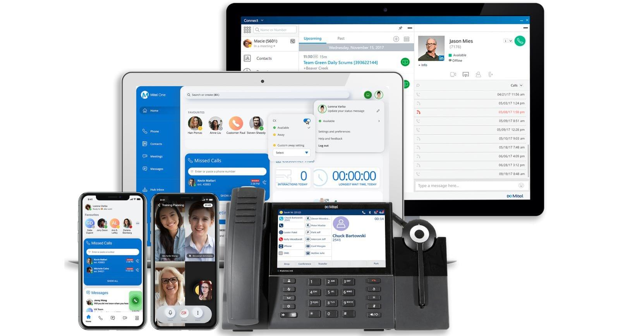



ABC CALL VOLUME TREND ANALYSIS
PROJECT NO-8

Slide 2
PROJECT DESCRIPTION:
In this project, we will move into the world of Customer Experience (CX) analytics, specifically focusing on the inbound calling team of a company. A dataset that spans 23 days and includes various details such as the agent's name and ID, the queue time (how long a customer had to wait before connecting with an agent), the time of the call, the duration of the call, and the call status (whether it was abandoned, answered, or transferred) is provided to us. The goal is to attract, engage, and delight customers, turning them into loyal advocates for the business.
APPROACH:
To perform the project a systematic approach was followed. A dataset having relevant information on agent's name and ID, the queue time, the time of the call, the duration of the call, and the call status was downloaded. Microsoft Excel 2021 was selected as the primary tool for data analysis due to its versatility and robust capabilities in handling tabular data. There are N/A in the dataset but as per the tasks those data columns are not required so they remain there in the dataset which will not affect our analysis.

Slide 3
TECH-STACK USED:
Software: Microsoft Excel 2021
Purpose: Excel was chosen for its extensive data analysis functions, including pivot tables, charts, and statistical functions and visualization of the call data
INSIGHTS: various key insights were uncovered through the data analytics process. These are the following tasks which have to be done as per the client requirement
Average Call Duration:
Call Volume Analysis
Manpower Planning
Night Shift Manpower Planning:

Slide 4
AVERAGE CALL DURATION:
Your Task: What is the average duration of calls for each time bucket?

Slide 5
Call_Status | answered
Time Bucket | Average of Call_Seconds (s)
10_11 | 203.33
11_12 | 199.26
12_13 | 192.89
13_14 | 194.74
14_15 | 193.68
15_16 | 198.89
16_17 | 200.87
17_18 | 200.25
18_19 | 202.55
19_20 | 203.41
20_21 | 202.85
9_10 | 199.07
Grand Total | 198.62

Slide 7
As seen in the graph we can clearly the average duration of calls for each time buckets for answered calls only. For 7pm-8pm the duration of calls is the highest and for 12 pm -1 pm the value is the lowest amongst all

Slide 8

CALL VOLUME ANALYSIS:
Your Task: Can you create a chart or graph that shows the number of calls received in each time bucket?

Slide 9
Time Bucket | Count of Customer_Phone_No | Count of Call_Seconds (s)
10_11 | 13313 | 11.28%
11_12 | 14626 | 12.40%
12_13 | 12652 | 10.72%
13_14 | 11561 | 9.80%
14_15 | 10561 | 8.95%
15_16 | 9159 | 7.76%
16_17 | 8788 | 7.45%
17_18 | 8534 | 7.23%
18_19 | 7238 | 6.13%
19_20 | 6463 | 5.48%
20_21 | 5505 | 4.67%
9_10 | 9588 | 8.13%
Grand Total | 117988 | 100.00%

Slide 11
Highest no of calls received during between 11 am to 12 pm as clearly seen in this graph

Slide 12
MANPOWER PLANNING:
Your Task: What is the minimum number of agents required in each time bucket to reduce the abandon rate to 10%?

Slide 13
Row Labels | Average of Call_Seconds (s) | Count of Customer_Phone_No | Count of Customer_Phone_No2
abandon | 0.00 | 34403 | 29%
answered | 198.62 | 82452 | 70%
transfer | 76.15 | 1133 | 1%
Grand Total | 139.53 | 117988 | 100.00%

Slide 15
The current rate of abandoned calls is approximately 30%.
Propose a plan for manpower allocation during each time bucket (from 9 am to 9 pm) to reduce the abandon rate to 10%.
In other words, you need to calculate the minimum number of agents required in each time bucket to ensure that at least 90 out of 100 calls are answered.
So

Slide 16
Time Bucket | Count of Call_Seconds (s) | Count of Call_Seconds (s)2 | call_seconds | Agent Required
10_11 | 11.28% | 0.11 | 0.11 | 6
11_12 | 12.40% | 0.12 | 0.12 | 7
12_13 | 10.72% | 0.11 | 0.11 | 6
13_14 | 9.80% | 0.10 | 0.10 | 6
14_15 | 8.95% | 0.09 | 0.09 | 5
15_16 | 7.76% | 0.08 | 0.08 | 4
16_17 | 7.45% | 0.07 | 0.07 | 4
17_18 | 7.23% | 0.07 | 0.07 | 4
18_19 | 6.13% | 0.06 | 0.06 | 3
19_20 | 5.48% | 0.05 | 0.05 | 3
20_21 | 4.67% | 0.05 | 0.05 | 3
9_10 | 8.13% | 0.08 | 0.08 | 5
Grand Total | 100.00% | 1.00 | 1.00 | 57

Slide 17
Date_&_Time2 | 01-Jan
Row Labels | Sum of Call_Seconds (s)
09 | 35313.00 |  | 188.0 | Per one day
10 | 53087.00 |  | 38 | As mentioned, 60%
11 | 67751.00 | So | 60% | 38
12 | 72680.00 |  | 90% | 57 | Total agent req
13 | 59693.00
14 | 76137.00
15 | 65689.00
16 | 59464.00
17 | 68155.00
18 | 53096.00
19 | 40141.00
20 | 25281.00
21 | 177.00
Grand Total | 676664.00

Slide 18
Total agent required are 57 and the minimum number of agents required in each time bucket to ensure that at least 90 out of 100 calls are answered are also shown by the table

Slide 19
NIGHT SHIFT MANPOWER PLANNING:
Your Task: Propose a manpower plan for each time bucket throughout the day, keeping the maximum abandon rate at 10%.

Slide 20
Count of Call_Status | Column Labels
Row Labels | abandon | answered | transfer | Grand Total
01-Jan | 684 | 3883 | 77 | 4644
02-Jan | 356 | 2935 | 60 | 3351
03-Jan | 599 | 4079 | 111 | 4789
04-Jan | 595 | 4404 | 114 | 5113
05-Jan | 536 | 4140 | 114 | 4790
06-Jan | 991 | 3875 | 85 | 4951
07-Jan | 1319 | 3587 | 42 | 4948
08-Jan | 1103 | 3519 | 50 | 4672
09-Jan | 962 | 2628 | 62 | 3652
10-Jan | 1212 | 3699 | 72 | 4983
11-Jan | 856 | 3695 | 86 | 4637
12-Jan | 1299 | 3297 | 47 | 4643
13-Jan | 738 | 3326 | 59 | 4123
14-Jan | 291 | 2832 | 32 | 3155
15-Jan | 304 | 2730 | 24 | 3058
16-Jan | 1191 | 3910 | 41 | 5142
17-Jan | 16636 | 5706 | 5 | 22347
18-Jan | 1738 | 4024 | 12 | 5774
19-Jan | 974 | 3717 | 12 | 4703
20-Jan | 833 | 3485 | 4 | 4322
21-Jan | 566 | 3104 | 5 | 3675
22-Jan | 239 | 3045 | 7 | 3291
23-Jan | 381 | 2832 | 12 | 3225
Grand Total | 34403 | 82452 | 1133 | 117988

Slide 21
5130 | TOTAL AVG CALLS
1539 | FOR NIGHT
76 | ADDITIONAL hr. REQ
15 | ADDITIONAL AGENT REQ

Slide 22
ASSUMPTION: we have an assumption value as provided for call between 9pm-9am and their call distribution value
CALL BETWEEN 9PM-9AM | CALL DISTRIBUTION | TIME DISTRIBUTION | AGENT REQUIRED | ROUND FIGURE
9PM-10PM | 3 | 10 | 1.5 | 2
10PM-11PM | 3 | 10 | 1.5 | 2
11PM-12PM | 2 | 15 | 1 | 1
12PM-1AM | 2 | 15 | 1 | 1
1AM-2AM | 1 | 30 | 0.5 | 1
2AM-3AM | 1 | 30 | 0.5 | 1
3AM-4AM | 1 | 30 | 0.5 | 1
4AM-5AM | 1 | 30 | 0.5 | 1
5AM-6AM | 3 | 10 | 1.5 | 2
6AM-7AM | 4 | 7.5 | 2 | 2
7AM-8AM | 4 | 7.5 | 2 | 2
8AM-9AM | 5 | 6 | 2.5 | 3
TOTAL | 30 |  | 15 | 19

Slide 23
Total Average calls are 5130
For night it was told that 30% of calls so 30%*5130= 1539
Then for additional hour we calculate by round formula
=round (1539*198.6*0.9/3600,0), it will result into 76 hr
Then for agent who work 5 hr in a day the we will, calculate by round formula =round (76/5,0) and we get 15 as additional agent required for the night hour Planning.

Slide 24
RESULT: We have achieved so many fruitful insights about the ABC Call Volume Trend Analysis by doing so many tasks such as call status, call duration, man power planning with the help of Microsoft Excel and its useful functions which will help us get better idea about how a call volume analysis have been doing
EXCEL LINK: PROJECT-8-ABC CALL VOLUME TREND ANALYSIS.xlsx
PPT LINK:

Slide 25
LINK THE EXCEL FILE

Slide 26


